Slide 1
Warehouse and Retail Alcohol Sales report and analysis
Detailed insights into sales trends and performance metrics
By Eric Buikema
Notes:
---
This presentation provides an in-depth analysis of alcohol sales performance in both warehouse and retail sectors. We will explore key metrics, sales trends, customer behaviors, and strategic recommendations to optimize growth and efficiency.

Slide 2
Key Focus Areas
Overview of Alcohol Sales Performance
Warehouse Alcohol Sales Analysis
Retail Alcohol Sales Analysis
Comparative Insights: Warehouse Vs. Retail
Strategic Recommendations and Future Outlook
Notes:
Our agenda covers five main sections: an overview of alcohol sales performance, detailed analyses of warehouse and retail sales, comparative insights between the two segments, and strategic recommendations for future growth.

Slide 3
Overview of Alcohol Sales Performance
In order to assess the findings, and generate a compelling analysis and sales report, multiple different sources was used. Excel was used to clean up an organize the data, organizing sections into pivot tables. MySQL for analyzing deeper trends and top performers. Power BI for the report and functional dashboard.
Notes:
This section introduces the objectives of the sales report, defines key metrics for analysis, and explains the data sources and methodology used to ensure the accuracy and reliability of findings.

Slide 4
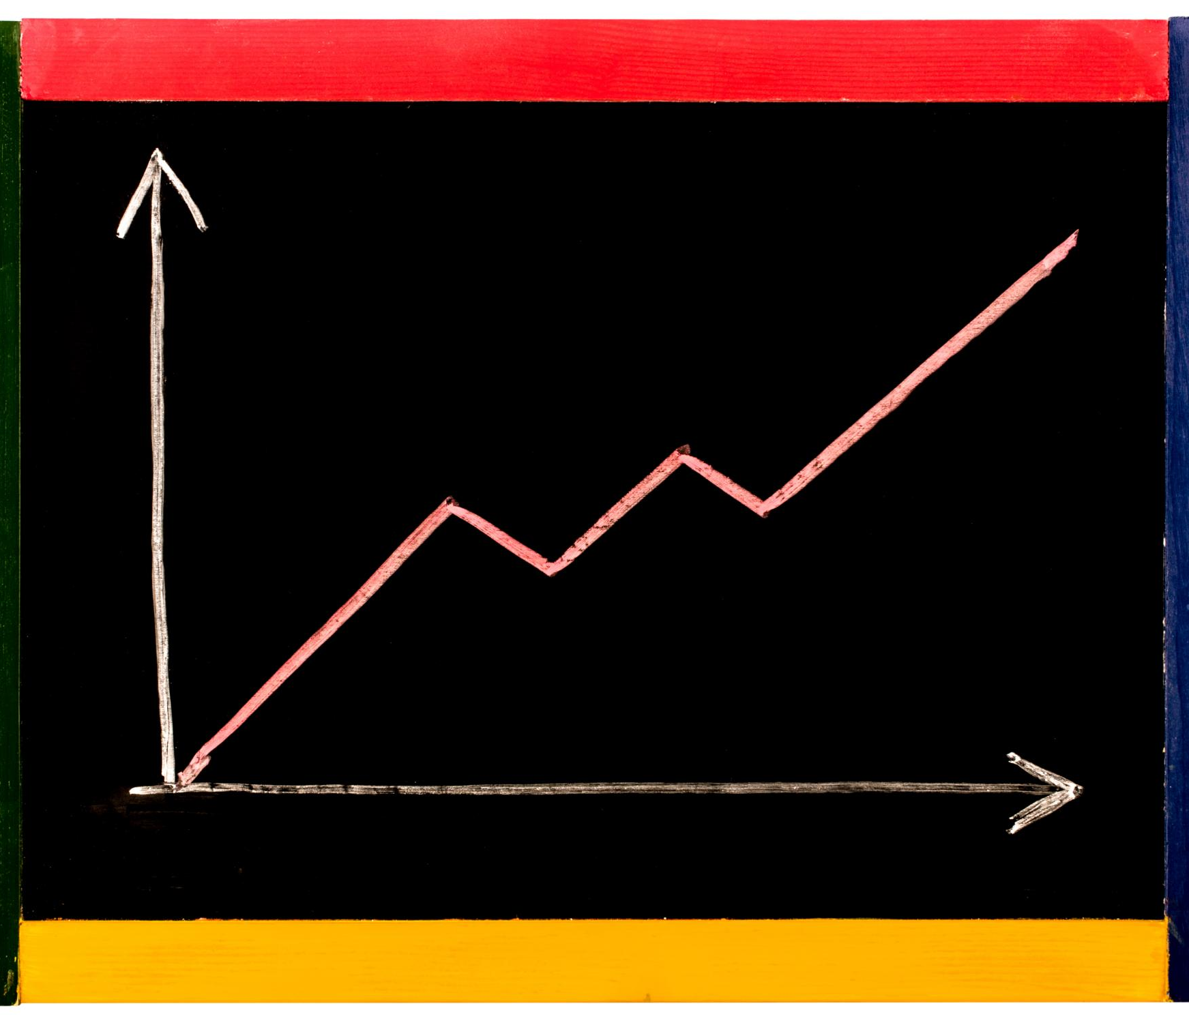
Objectives of the Sales Report
Understanding Sales Trends
  Analyze sales data to recognize patterns and shifts over time for better forecasting.
Identifying Top Products
  Determine highest performing products to focus marketing and inventory efforts strategically.
Evaluating Inventory Management
  Assess inventory levels and turnover rates to optimize stock and reduce waste.
Supporting Decision-Making
  Provide actionable insights to improve decisions for warehouse and retail channel operations.
Notes:
The primary objectives include understanding sales trends, identifying high-performing products, evaluating inventory management, and supporting informed decision-making for both warehouse and retail channels.

Slide 5
Key Metrics and Definitions
Sales Volume
  Sales volume measures the total quantity of products or services sold over a specific period.
Revenue
  Revenue represents the total income generated from sales before expenses are deducted.
Inventory Turnover
  Inventory turnover indicates how often inventory is sold and replaced during a period.
Biggest Sellers
  Based on total sales amount of volume of which each item is purchased
Notes:
We will clarify the essential metrics such as sales volume, revenue, inventory turnover, customer demographics, and promotional impact to provide a clear framework for the analysis.

Slide 6

Data Sources and Methodology
Data Sources Overview
  The report utilizes sales records, inventory data, customer purchases, and market research as primary data sources.
Analysis Techniques
  Quantitative analysis and comparative methods are applied to derive robust and actionable insights from data.
Notes:
The report is based on sales records, inventory data, customer purchase information, and market research. We employ quantitative analysis and comparative methods to ensure robust insights.

Slide 7
Warehouse Alcohol Sales Analysis
Notes:
This section examines the warehouse segment's sales volume and revenue trends, identifies top-performing product categories, and reviews inventory turnover alongside current stock levels.

Slide 8
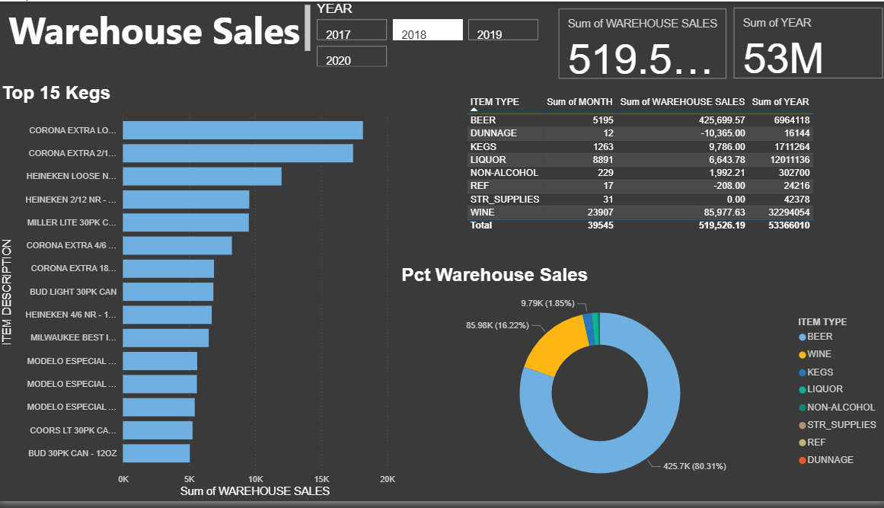
Warehouse sales and revenue trends
Best Sellers
Beer is clearly the best seller at the warehouse. Not the same kind of beer is top in warehouse. Wine is also a top seller
Kegs
Many kegs in the warehouse are hardly sold. Long list of kegs that never sell. Don’t waste space.]
Top Kegs
- The best-selling kegs hardly change. Invest more space into the best-selling kegs

Slide 9
Retail Alcohol Sales Analysis
Notes:
This section explores sales volume and revenue trends within retail, customer purchasing patterns and demographics, as well as the effects of promotions and seasonal variations.

Slide 10
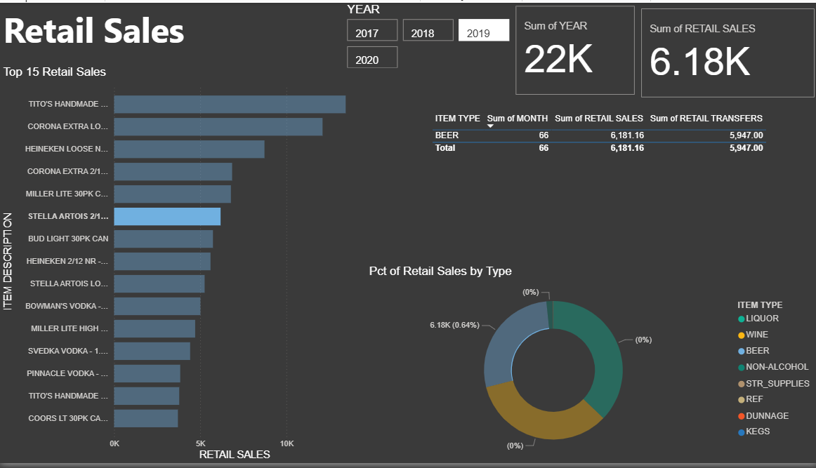
Retail Sales Volume and Revenue Trends
Consumer Demand Fluctuations
  While customer demand and taste changes slightly overtime. The main sellers never change dramatically, as shown in the report
Revenue Changes
  Sharp decrease in sale during the year 2019. Slight rebound in 2020.
Retail Segment Performance
  Analyzing sales and revenue data helps evaluate the performance of various retail categories and market sectors.
Notes:
An overview of retail sales data reveals consumer demand fluctuations and revenue changes, providing insight into retail segment performance.

Slide 11
Comparative Insights: Warehouse Vs. Retail
Notes:
In this section, we compare sales performance and distribution efficiency between warehouse and retail channels, identifying strengths and areas for improvement.

Slide 12
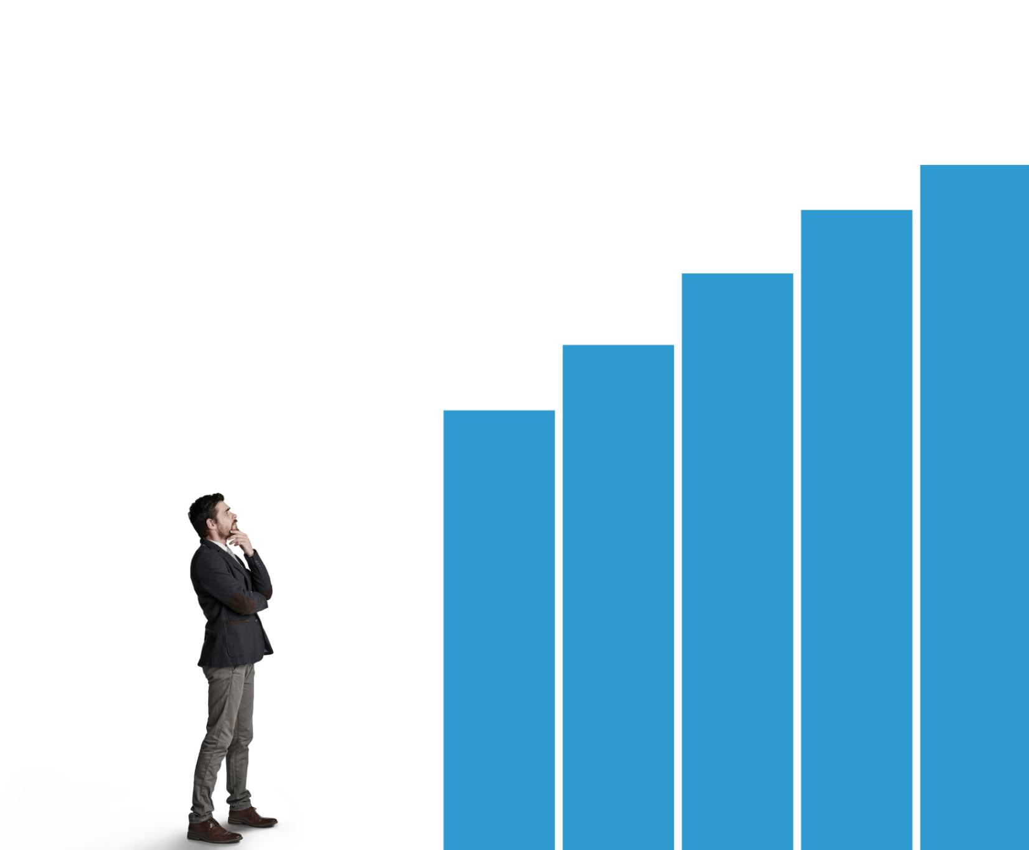
Comparison of Sales Performance
Sales Volume Comparison
  Warehouse and retail sectors show different sales volumes, revealing distinct market demands and customer reach.
Revenue Analysis
  Revenue figures highlight the financial impact of each sector, emphasizing profitability and business scale.
Growth Trends
  Examining growth trends helps identify which sector drives more sustainable business expansion.
Notes:
We contrast sales volumes, revenues, and growth trends in the warehouse and retail sectors to understand their relative contributions to overall business success.

Slide 13

Analysis of Distribution Efficiency
Warehouse Operations
  Top-selling kegs maintain dominance, invest in space for those. Make sure to pay attention to kegs of wine
Retail Channel Movement
  Make sure adequate space is invested for big sellers.
Supply Chain Challenges
  Many kegs do not sell. Stop supplying those kegs
Notes:
This slide reviews how effectively products move through warehouse and retail channels, spotlighting logistics, supply chain management, and potential inefficiencies.

Slide 14

Recommendations for Optimization
Big Sellers
  Focus on promoting the top sellers in both spaces to save on wasted space.
Bad Sellers
  Many brands do not sell. Stop supplying them and save space for best sellers
Unique Opportunity
  Non-alcoholic sales has jumped considerable in 2020. Make sure to invest shelf space for non-alcoholic sales
Notes:
Based on comparative insights, we suggest actionable strategies to enhance sales, inventory management, and customer engagement across both segments.

Slide 15
Strategic Recommendations and Future Outlook
Notes:
The final section outlines growth opportunities, potential challenges, and market trends to position the business advantageously in the evolving alcohol sales market.

Slide 16

Opportunities for Growth in Both Sections
Product
  Focus on providing the biggest sellers to optimize what has shown to sell.
Warehouse vs Retail
  Tailor each space to what sells the best and focus on improving in those areas.
Non-Alcoholic
  Non-alcoholic will be big in the future, as shown by the considerable jump in 2020. Invest into non-alcholic products.
Notes:
We identify areas such as product diversification, digital sales channels, and customer experience enhancements that can drive growth in warehouse and retail areas.

Slide 17
Conclusion: Driving Success Through Insightful Analysis
Value of Detailed Analysis
Thorough analysis of alcohol sales data reveals key insights that drive informed business decisions.
Strategic Decision Making
Insights from data support effective strategies that enhance growth and operational efficiency.
Sustained Growth and Excellence
Implementing recommendations fosters continuous growth and operational excellence over time.
Notes:
Through detailed analysis of warehouse and retail alcohol sales, we gain valuable insights to inform strategic decisions. Implementing these recommendations will support sustained growth and operational excellence.

